Slide 1
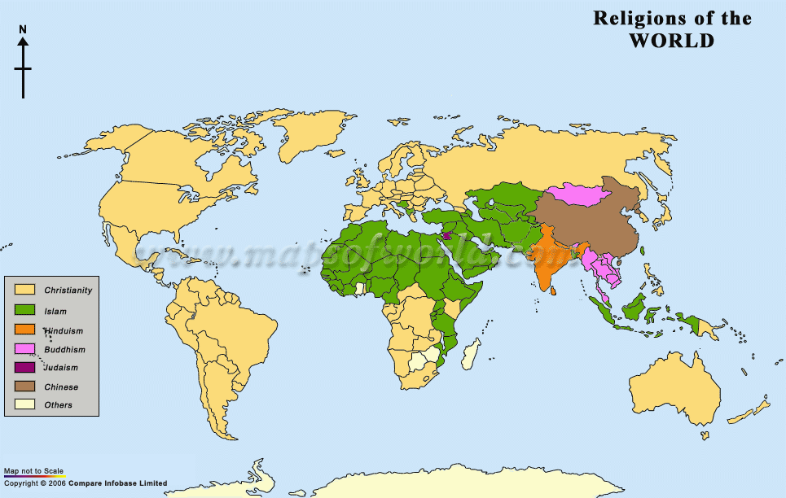
Notes:
http://maps.unomaha.edu/Peterson/geog1000/MapLinks/ReligionMaps.html

Slide 2
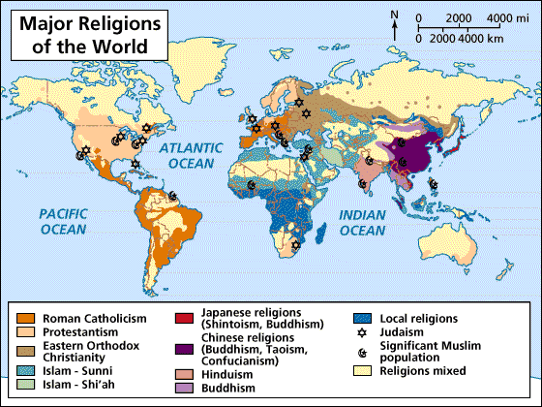

Slide 3
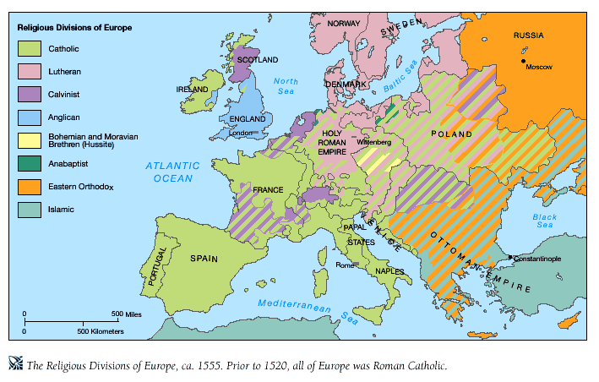
Notes:
http://teacherweb.ftl.pinecrest.edu/snyderd/MWH/Projects/cov/maps/MapRel.htm

Slide 4
Table 29 of the study presents the percent of people raised in a
particular religion who reported currently being members of that same
faith:
Table 29
A. Major Religions
Protestant 90.4%
Catholic 82.3
Jewish 86.6
Other 70.5
None 45.4
source:
"Counting Flocks and Lost Sheep:"
http://www.icpsr.umich.edu:8080/GSS/rnd1998/reports/s-reports/soc26.htm
http://answers.google.com/answers/threadview?id=272042

Slide 5
B. Major Protestant Denominations
Southern Baptist 71.8
United Methodist 63.0
Lutheran 80.0
Presbyterian 56.7
Episcopalian 71.6
Interdenominational 47.1
Disciples of Christ 63.9
Mormon 90.8
Fundamentalist 73.7
Moderate 57.0
Liberal 46.4
C. Fundamentalism/Liberalism
Fundamentalist 80.3
Moderate 81.9
Liberal 71.6

Slide 8
Notes:
http://www.niobium.fr/dotclear/public/humeur/SexandSecularismTheReport.pdf

Slide 12

Religious guilt cycle 16:00. Did Jesus? 28:50

